Slide 1


Source Control

Slide 2

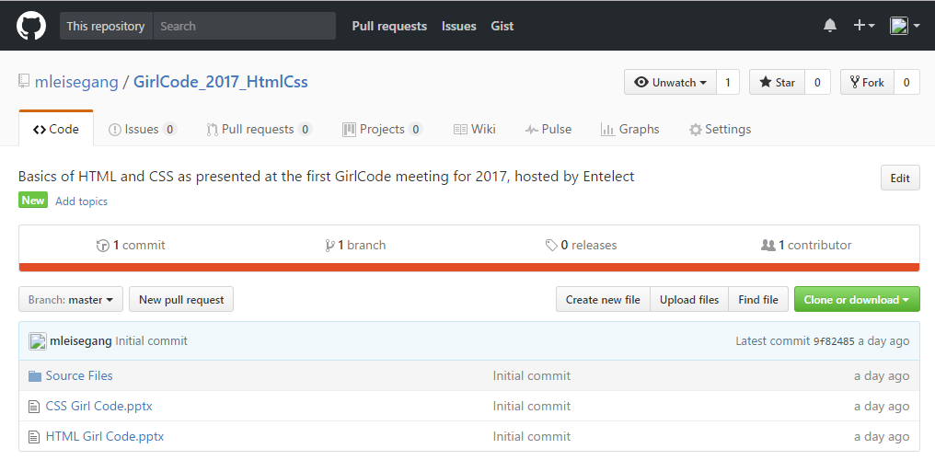
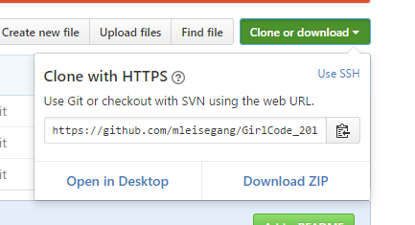
Download today’s files here:
https://github.com/mleisegang/GirlCode_2017_HtmlCss
Notes:
I’m really only here to tell you that you can download todays presentations and code files from git hub. Browse to the link.
Click on the green Clone or Download button
Click on the Download Zip button.
Right. So what does this cute kitty have to do with writing code?

Slide 3
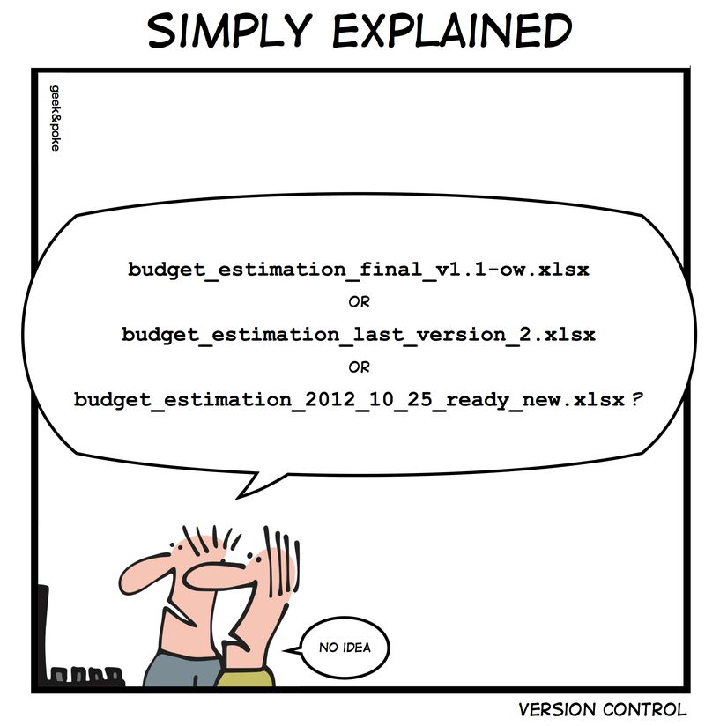
What is VERSION CONTROL
?
Notes:
Imagine you’re working on something and it’s going well. Then you say “Let me just…” add something fancy and somewhere along the line things stop working. What do you do then? Ctrl+Z of course!

Slide 4
When Ctrl+Z doesn’t go back far enough…
Notes:
Except ctrl+Z only goes back five actions and now things are looking even worse. It’s like adding too much salt to your pasta dish – you just can’t go back from there. [click animation]
That’s when you wish you had a snapshot of the last time you said “This is good”. And that is version control in a nutshell. Having snapshots of your work as you go along

Slide 5
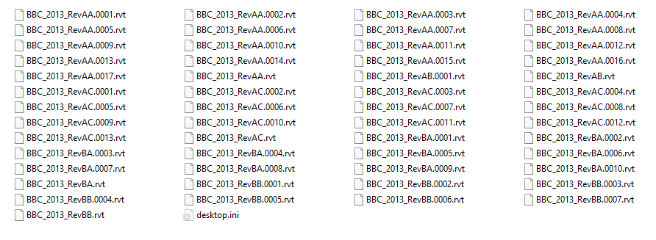
Snapshots for future reference
Notes:
Here is a good example of version control. The only problem is it’s really hard to figure out which is the final final final version. Can you spot the final final final version? [click animation]
What if I change my mind and want to go back to a previous version? [click animation]
How would I know which version I want without opening every single file to find the specific feature I’ve changed my mind about?

Slide 6
So what?
How is this relevant to software development?
Go back to working version
Remind yourself/inform others of design decision
Know exactly what is in production
Version Control
Source Code
Source Control
Notes:
These are scenarios that you will often come across in software development. For instance your boss says he liked the previous red, round button better than the current square blue button, or when someone snuck in a piece of code to cheat on emissions tests and you need to remove it quickly…
So how is this relevant to software development? [click animation]
With a good source control strategy, you can easily go back to previous working versions[click animation]
If your changes are well commented it can remind you or inform others of design decisions (which is easier than opening 54 files in turn) [click animation]
And to know exactly what version of the software/code is currently deployed in the real world. This is useful when you’ve carried on developing new features but you need to go back and fix a bug in an older version.

Slide 7
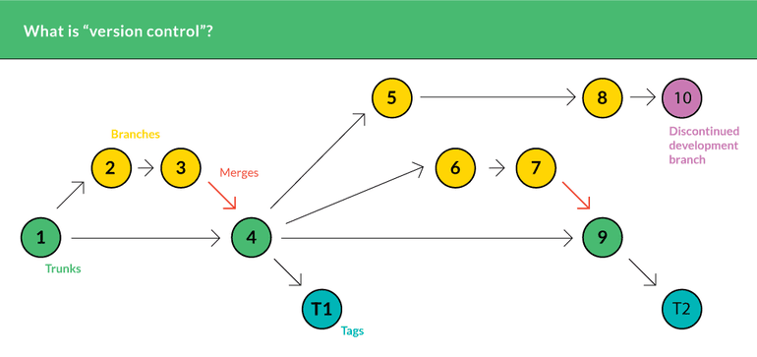
How to not end up with 54 files…
Notes:
This is how a basic source control timeline may look. In green we have the main branch of the code, here called the trunk. In yellow you see features being developed independently of the trunk to avoid rendering the trunk unusable by others if you mess up. So a branch is created when you want to work on something in isolation. When you are done you can merge it back into the trunk as is seen at point 3 merging into 4 and 7 into 9.
Branch 5 didn’t work out but it’s not in trunk so you don’t have to ctrl z that bad boy. It’s ok to just leave it hanging..
T1 and T2 in blue are public releases of this software.

Slide 8
Enter GIT…
Cloud based source control tool
Great for collaboration
Many open source libraries
Get today’s stuff here:
https://github.com/mleisegang/GirlCode_2017_HtmlCss.git
Notes:
SO this is where git comes in. It is great for source control. It also aides in collaboration.

